Slide 1


Building an AI Pipeline for Image Segmentation and Object Analysis
This presentation outlines the steps involved in building an AI pipeline that utilizes image segmentation, object detection, and attribute analysis to generate a comprehensive output summary.
By Karthikeya Tallapaneni
Karthikeyaa.official@gmail.com

Slide 2
Image Segmentation
1
Segmentation Techniques
Image segmentation is the process of dividing an image into multiple segments, each representing a distinct object or region of interest. Common techniques include thresholding, edge detection, region growing, and clustering.
2
Pre-Trained Models
Leveraging pre-trained models, such as Mask R-CNN or DETR, enables efficient and accurate segmentation of objects, leveraging existing knowledge and reducing training time.
Instance Segmentation
Instance segmentation goes beyond semantic segmentation by identifying and separating individual instances of the same object category. This allows for object-level analysis and tracking.
3
Semantic Segmentation
Semantic segmentation involves assigning a label to each pixel in an image, classifying it as belonging to a specific object category. This provides detailed information about the image content.
4

Slide 3
Implement a model or use a pre-trained model for image segmentation
Model Selection
Choose an appropriate segmentation model based on the specific requirements of the task, considering factors such as model accuracy, speed, and computational resources.
1
Data Preparation
Prepare a labeled dataset with images annotated with segmentation masks, ensuring sufficient data diversity and quality for optimal model training.
2
Model Training
Train the selected model on the prepared dataset, optimizing hyperparameters and evaluating model performance to achieve desired accuracy levels.
3
Model Evaluation
Evaluate the trained model using metrics like intersection over union (IoU) and accuracy, ensuring the model meets the performance requirements for the task.
4
Model Deployment
Deploy the trained model for inference, enabling seamless segmentation of new images and integration with the broader AI pipeline.
5

Slide 4
Object Detection and Classification
Object Detection
Object detection aims to identify and locate objects of interest within an image, drawing bounding boxes around them and assigning them to specific categories.
Classification
Object classification involves assigning a label to each detected object, indicating its category or type based on learned features and patterns. This provides semantic understanding of the objects.
Object Localization
Object localization involves determining the precise location of objects within the image, providing accurate coordinates for bounding boxes that enclose the detected objects.

Slide 5
Identify and classify objects within the segmented image
Feature Extraction
Extract relevant features from the segmented objects, such as shape, texture, and color, to provide a basis for classification.
Feature Representation
Represent the extracted features in a suitable format, such as vectors or matrices, to facilitate efficient processing by classification algorithms.
Classification Model
Train a classification model using labeled data, enabling the model to learn relationships between features and object categories.
Object Labeling
Apply the trained classification model to the segmented objects, assigning labels to each object based on their learned features.

Slide 6
Object Attribute Analysis
Color Analysis
Determine the dominant colors and color patterns present within each detected object, providing insights into its appearance and aesthetic properties.
Shape Analysis
Analyze the shape of each object, identifying its geometric properties like contours, corners, and edges, and classifying it based on shape features.
Texture Analysis
Extract texture information from each object, characterizing its surface properties, such as smoothness, roughness, and patterns, providing insights into its material and texture.
Size and Dimension Analysis
Measure the size and dimensions of each object, providing quantitative data about its physical properties, such as height, width, and depth.

Slide 7
Output Summary
Object Count
Summarize the total number of objects detected and classified, providing a high-level overview of the image content.
Object Table
Generate a detailed table listing each detected object, including its class, attributes, and any relevant metadata, providing a comprehensive summary of the analysis.
Report Generation
Generate a report that combines the object table and other relevant analysis results, providing a comprehensive document that summarizes the findings.

Slide 8
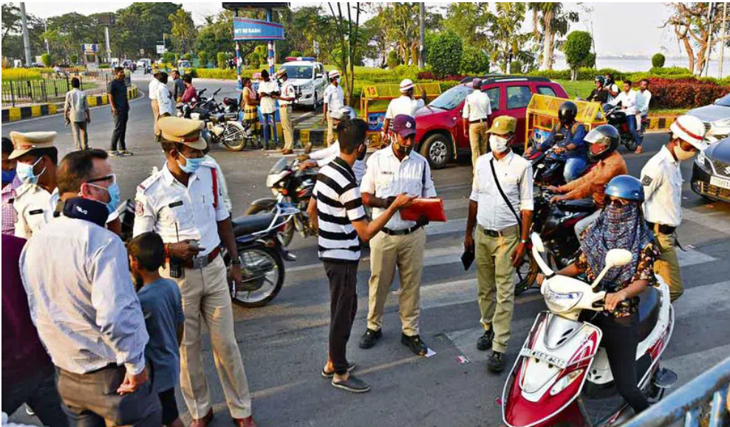
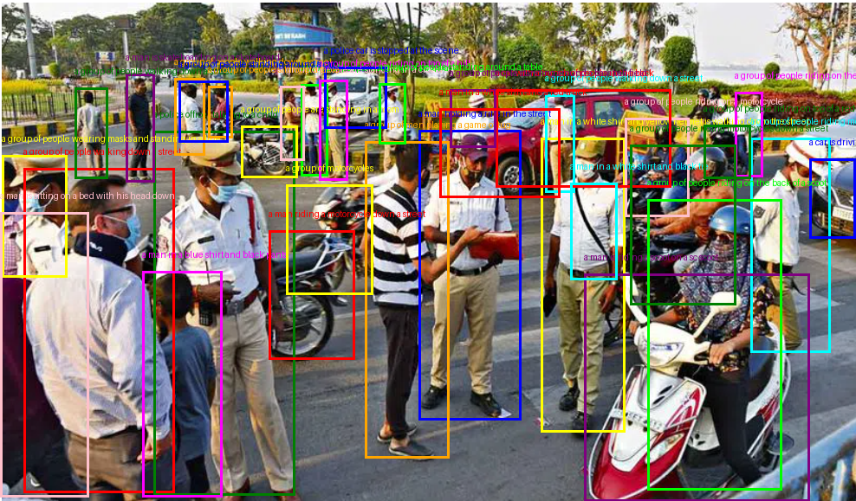
Deliverables
Input:-
Output:-

Slide 9
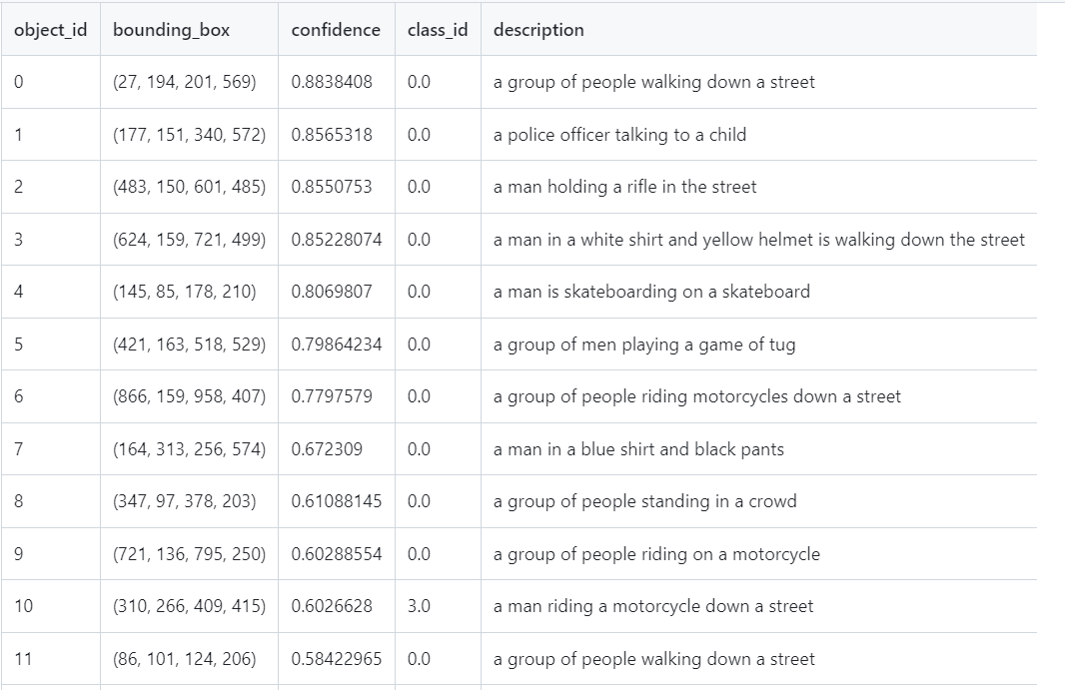
Report generation

Slide 10
THANK YOU
For any Queries contact
+91 8978796351
Karthikeyaa.official@gmail.com

